Slide 1



LEGALBOT: AI-POWERED
JUDICIARY REFERENCE SYSTEM
Bridging the Gap Between Citizens and Indian Legal Codes (BNS, BNSS, BSA)
Presented By:
Rishwanth Bezawada
Mentor
Deepak Sir
Coordinator

Slide 2
PROBLEM STATEMENT
Indian legal documents (like the new BNS, BNSS, and BSA codes) are vast, complex, and written in technical jargon.
Common citizens and even junior legal professionals struggle to find specific sections relevant to their problems
(e.g., "What is the punishment for snatching?").
Traditional search tools rely on exact keyword matching, which often fails if the user doesn't know the exact legal terms.
The Solution:
LegalBot: An intelligent chatbot that understands natural language queries.
It uses AI to interpret the user's intent, retrieves the exact legal sections from the official PDF documents, and generates a simplified, accurate explanation.

Slide 3


TECH STACK
Frontend:
Streamlit: For building a responsive, professional web-based user interface (UI).
Backend & Logic:
Python: The core programming language.
Google Gemini Pro: Large Language Model (LLM) for generating human-like answers.
Data Processing & NLP:
PyPDF2: For extracting raw text from legal PDF documents.
NLTK & SpaCy: For Natural Language Processing (tokenization, lemmatization, stop-word removal).
Scikit-Learn: For TF-IDF Vectorization and Cosine Similarity (ranking search results) and Logistic Regression (query classification).
Data Storage:
JSON: For storing structured legal sections, user credentials, and chat history.

Slide 4
KEY FEATURES
Retrieval-Augmented Generation (RAG): The bot doesn't just "guess"; it fetches the actual legal text from the BNS/BNSS/BSA files to ground its answers in reality.
Smart Query Classification: Uses Machine Learning to automatically detect if a question is Criminal (searches BNS), Procedural (searches BNSS), or Evidentiary (searches BSA).
Hybrid Search Engine: Combines Regex (for direct "Section 302" lookups) with TF-IDF/Cosine Similarity (for conceptual searches like "theft" or "arrest").
User-Centric UI: Includes a Sidebar with "New Chat", History logs, Bookmarks for saving important answers, and Quick Action buttons for common laws.
Feedback Loop: Users can rate answers (1-5 stars) and mark them as "Useful" or "Useless," which is logged for system improvement.

Slide 5
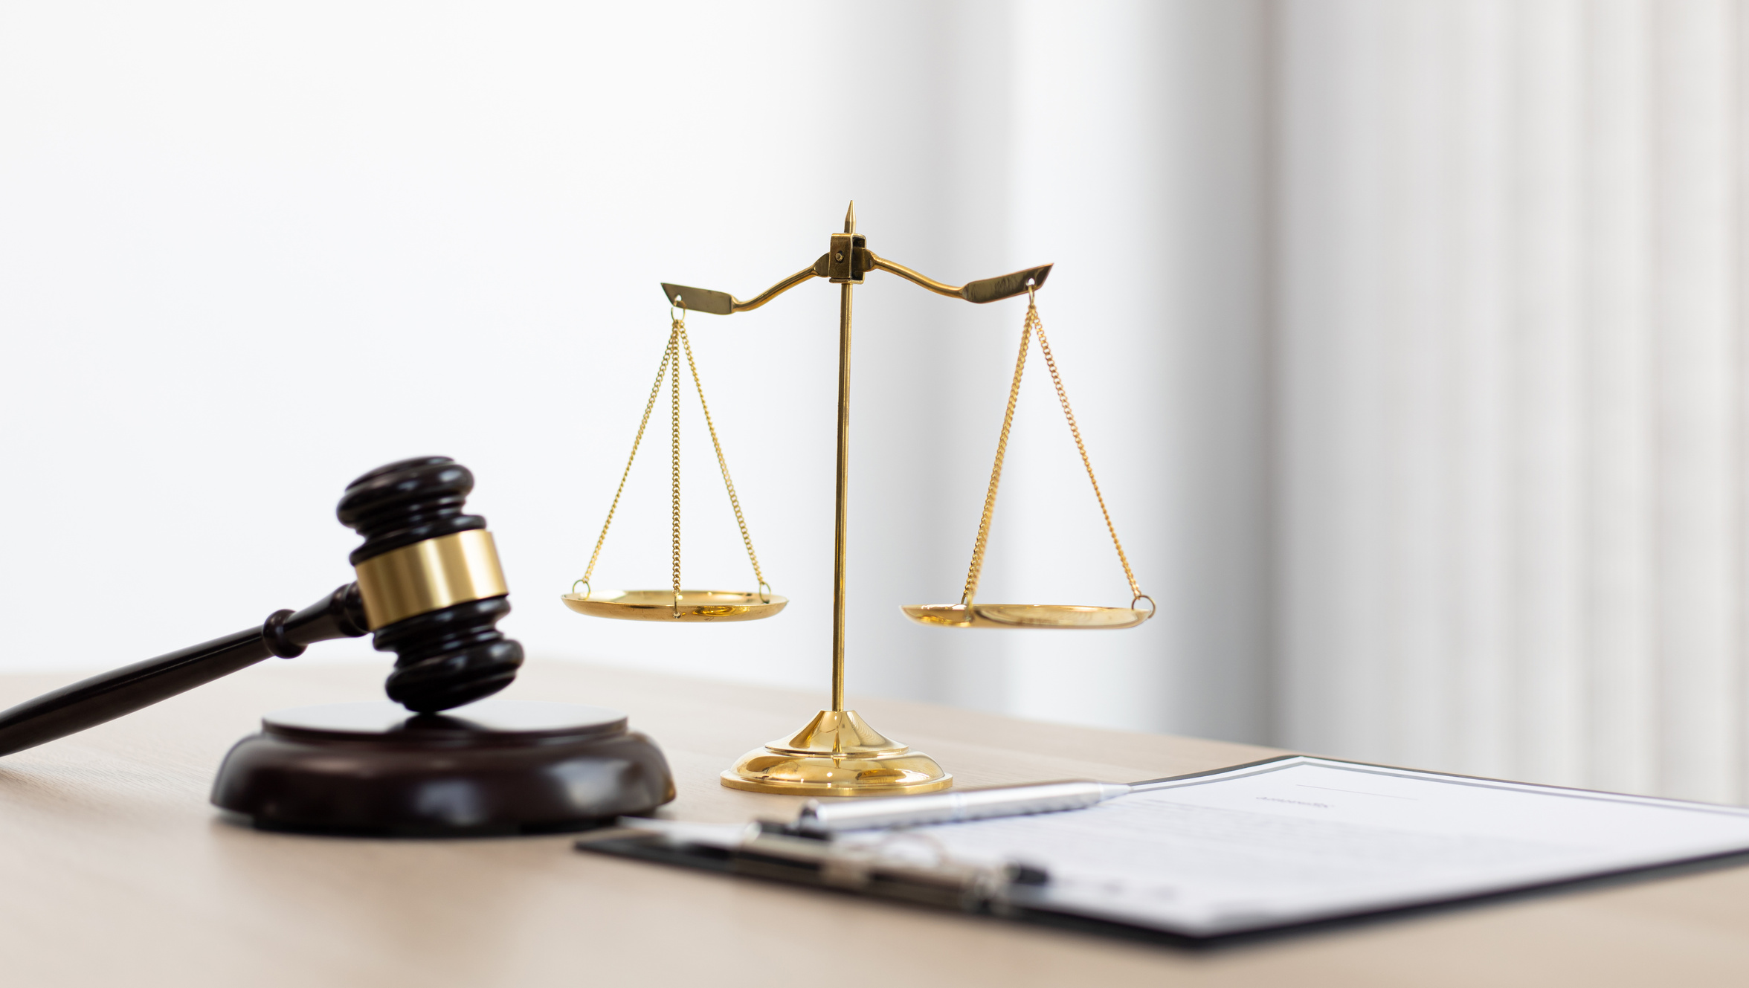
CHALLENGES & SOLUTIONS
Challenge 1: Complex PDF Formatting
Issue: The raw PDF files had inconsistent formatting (e.g., Section titles appearing on different lines than section numbers), causing the extractor to miss critical sections like "Murder" (Sec 99) and "Kidnapping" (Sec 135).
Solution: Developed a robust, multi-line Regular Expression (Regex) script in pdf_extractor.py to accurately parse and structure every single section.
Challenge 2: Irrelevant Search Results
Issue: Simple keyword searches were matching common words (e.g., "mean" in "what does this mean") to unrelated legal text.
Solution: Implemented NLP Preprocessing (Lemmatization) to strip filler words and used Cosine Similarity ranking to ensure only the most statistically relevant sections are sent to the AI.
Challenge 3: State Management
Issue: Chat history and user login status were lost whenever the user clicked a button.
Solution: Utilized Streamlit's session_state to persist user history, authentication status, and bookmarks across app reruns.

Slide 6
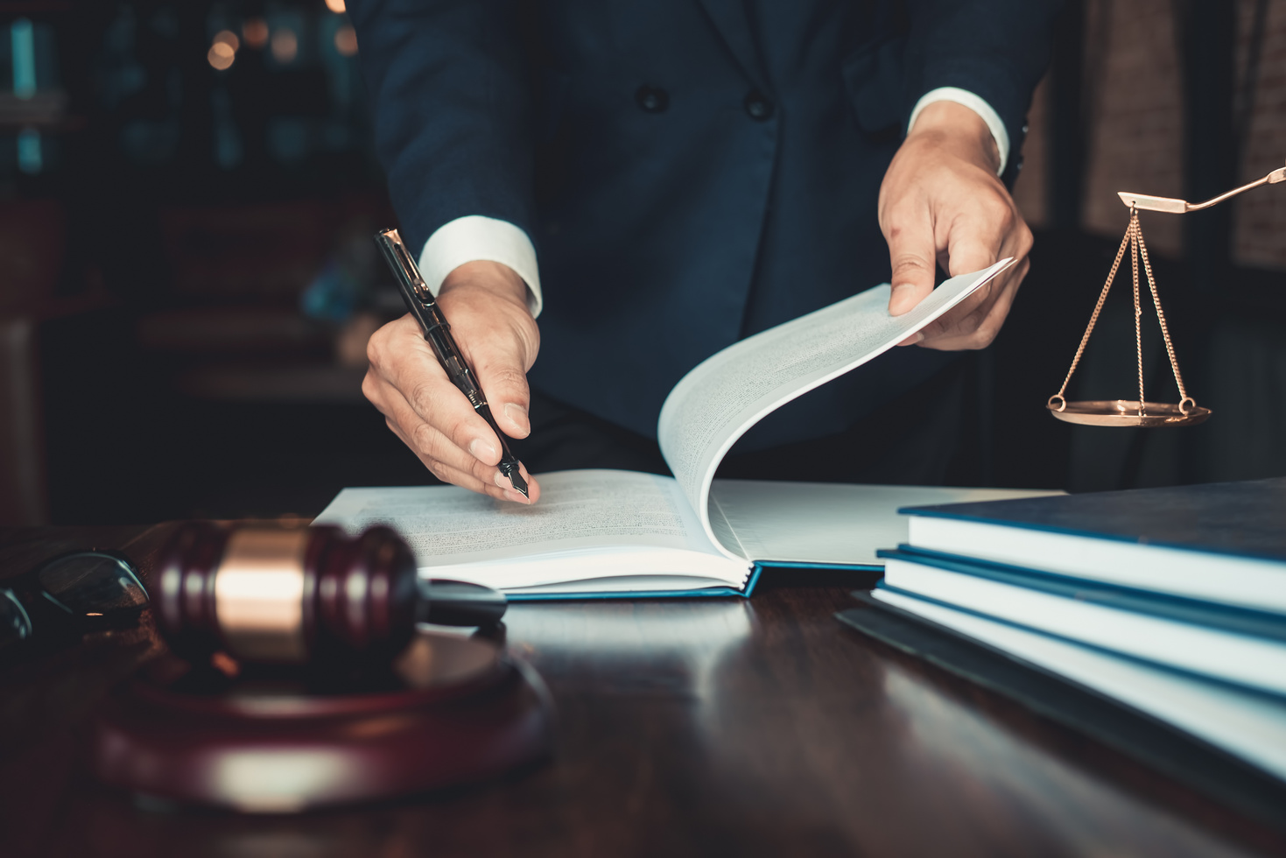
FUTURE SCOPE
Multilingual Support: Integrating translation APIs to allow users to query in Hindi, Telugu, Tamil, etc.
Voice Interface: Adding Speech-to-Text for accessibility, allowing users to speak their legal problems.
Case Law Database: Expanding the dataset to include actual Supreme Court judgments and case laws, not just the bare acts.
Document Analysis: allowing users to upload their own legal notices or documents for the AI to summarize and explain.

Slide 7
CONCLUSION
LegalBot successfully demonstrates how modern AI can democratize access to justice.
By combining traditional information retrieval techniques with Generative AI (Gemini), we created a system that is both accurate (cited sources) and accessible (natural language).
The project bridges the gap between complex legal codes and the common citizen, empowering users with instant legal knowledge.

Slide 8

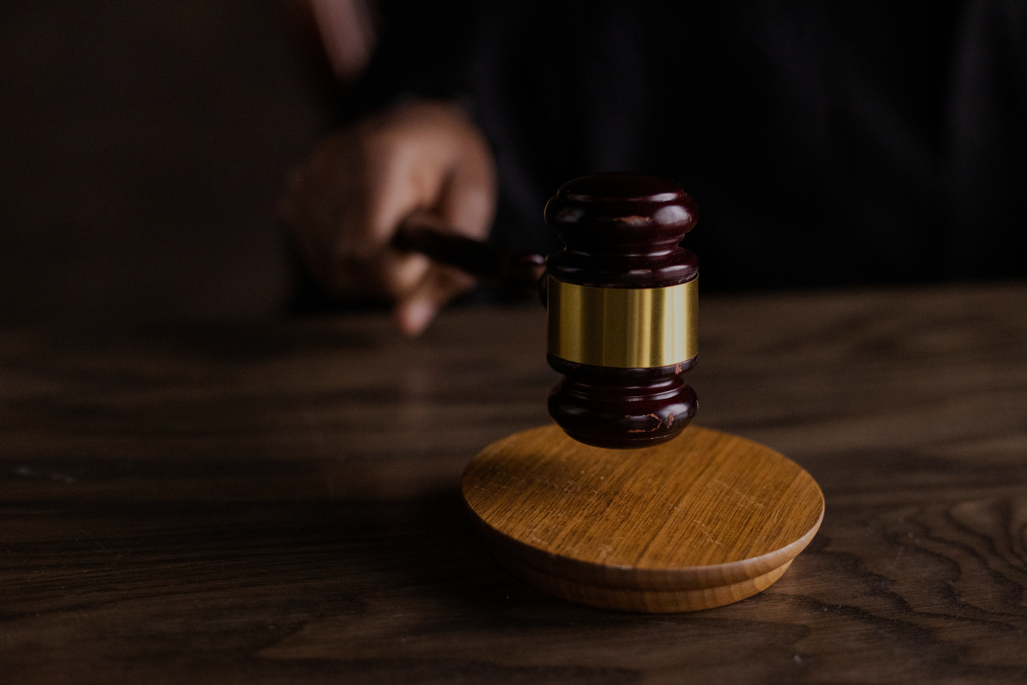

THANK YOU!
Thank you for learning about the vital role of lawyers in ensuring justice and legal harmony.

